Slide 1
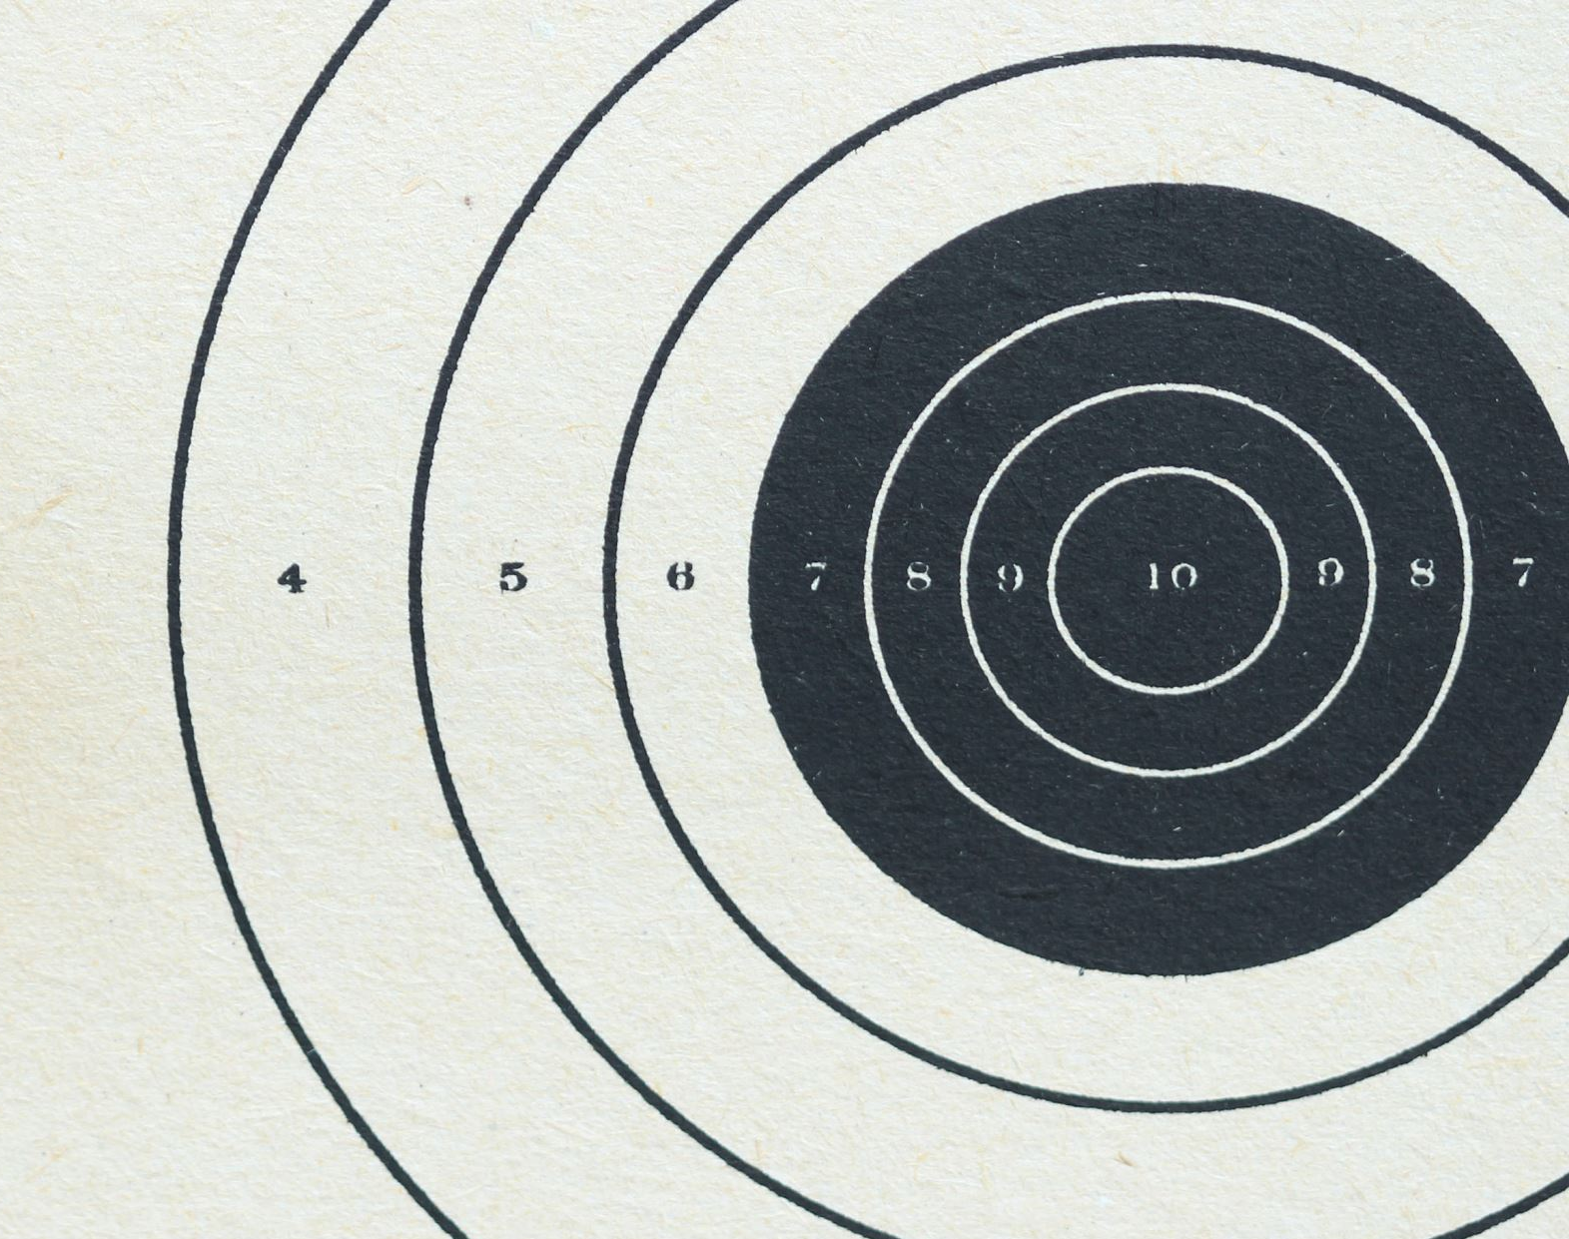
Accuracy Trend with Different Image Sizes and Contrast

Slide 2
Compare between part whole test and part whole flip test
Trend with different image sizes

Slide 3
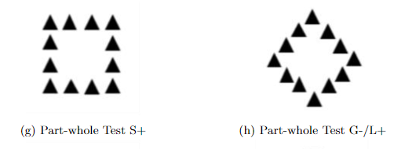
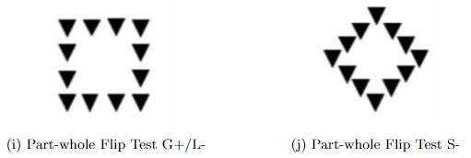
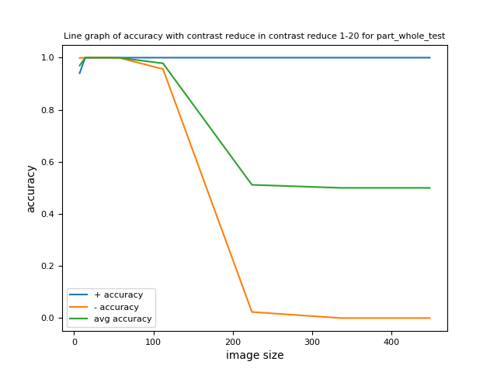
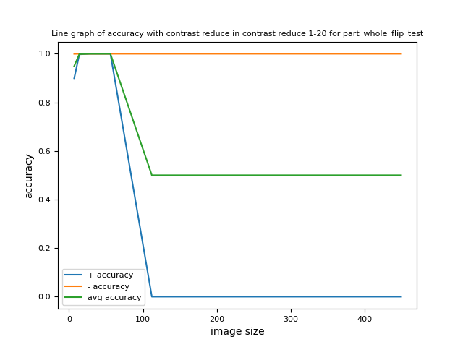
Compare with different image sizes
Image pixel values are binary, either 0 or 255.
Contrast reduce 1-20 means when pixel value equals to 255, it deducts a random integer between 1 and 20.
When pixel value equals to 0, it adds a random integer between 1 and 20.
Image sizes include 7*7, 14*14, 28*28, 56*56, 112*112, 224*224, 336*336 and 448*448.

Slide 4
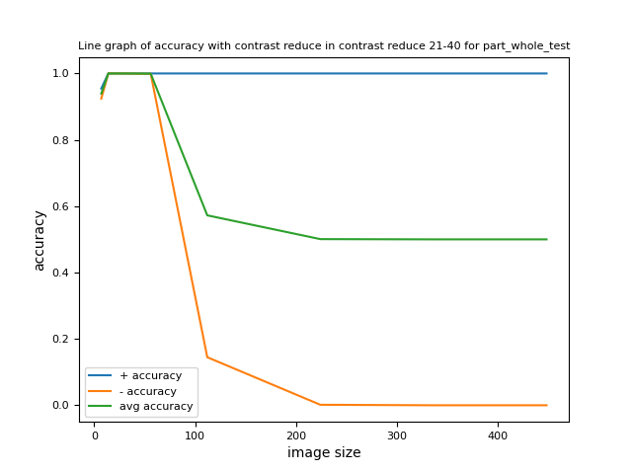
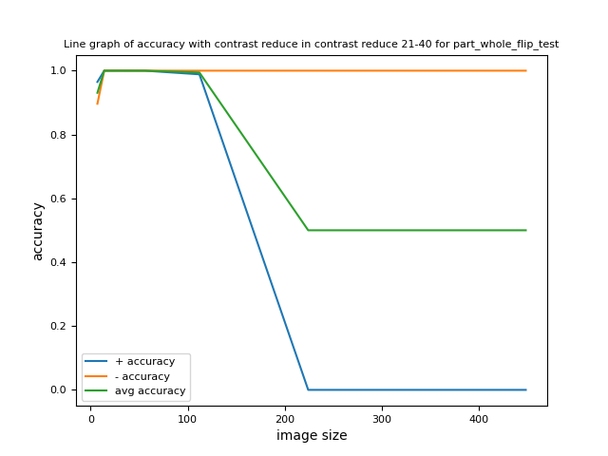
Compare with different image sizes
Part whole test and part whole flip test have the same global feature but have different local feature.
The local feature triangle is flipped in part whole flip test.
The model tends to classify the image according to the local feature when image size is higher than 56*56.
In part whole test, the model tends to classify all images as plus when image size is higher than 56*56.
In part whole flip test, the model tends to classify all images as minus when image size is higher than 112*112.

Slide 5
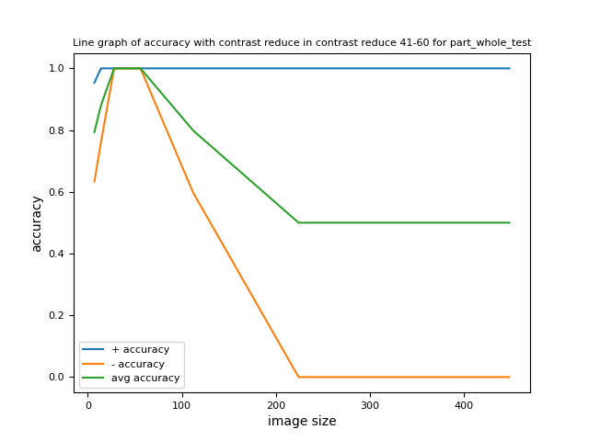
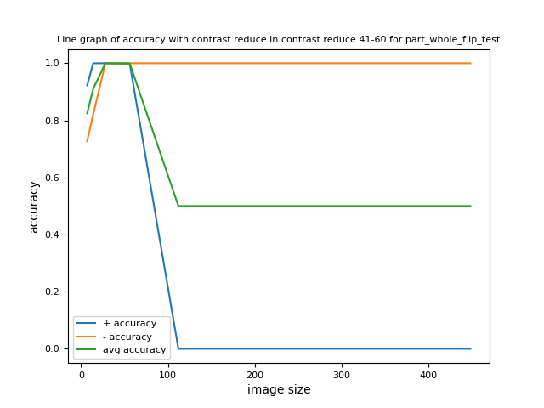
Compare with different image sizes

Slide 6
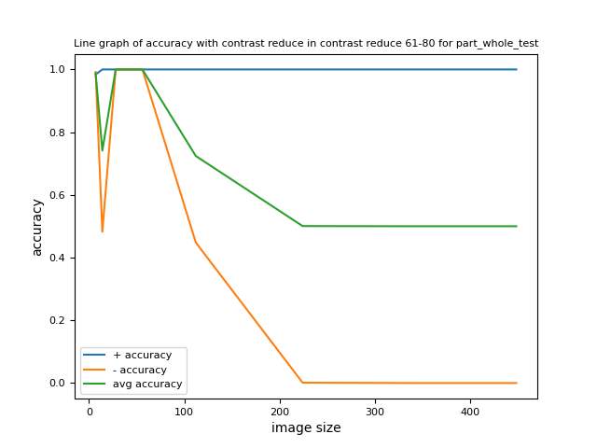
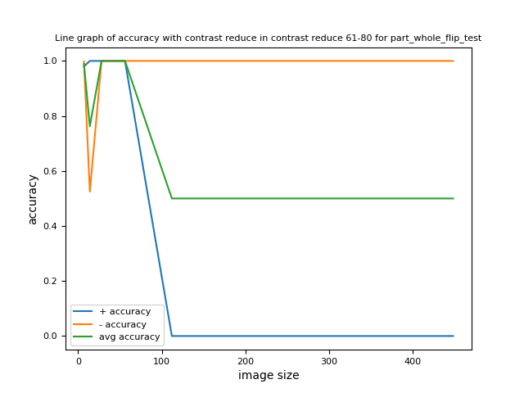
Compare with different image sizes

Slide 7
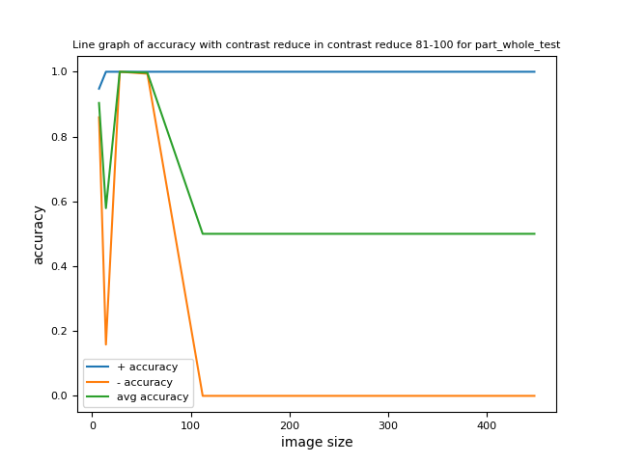
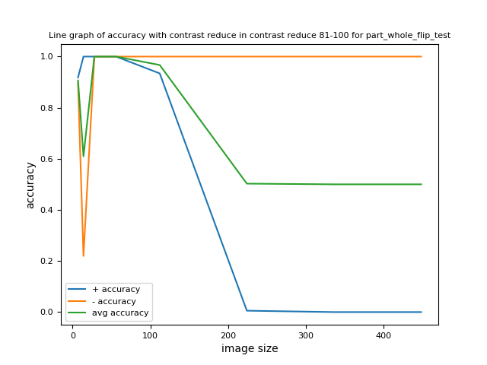
Compare with different image sizes

Slide 8
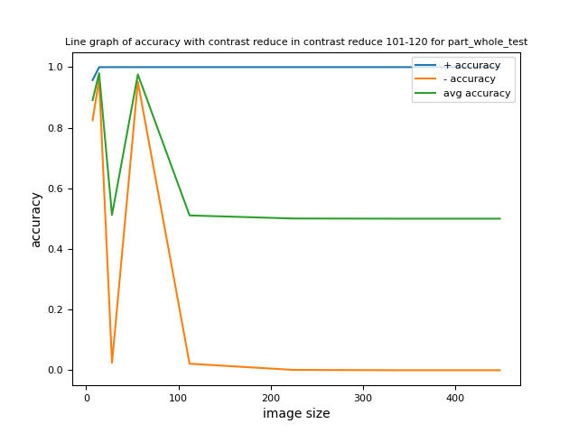
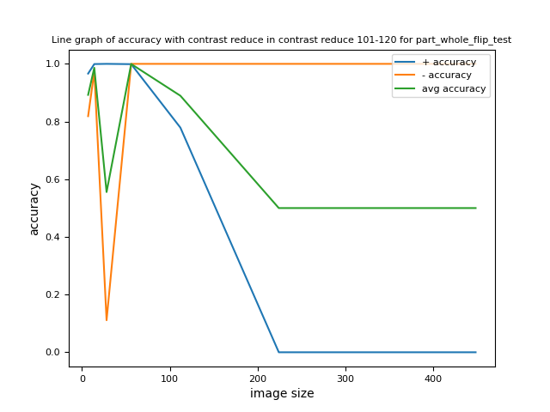
Compare with different image sizes

Slide 9
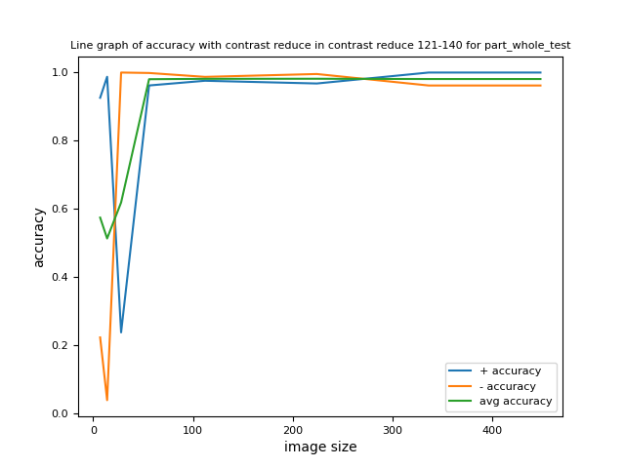
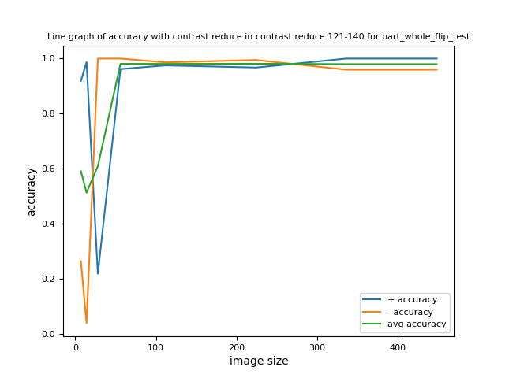
Compare with different image sizes
When image contrast is very low (contrast reduce 121-140), the model tends to have high accuracy when image size is larger than 56*56.
Images with contrast reduce 121-140 have the lowest contrast.
When image size is larger than 56*56, low contrast tends to have high accuracy. While when image size is lower than 56*56, high contrast tends to have high accuracy.

Slide 10
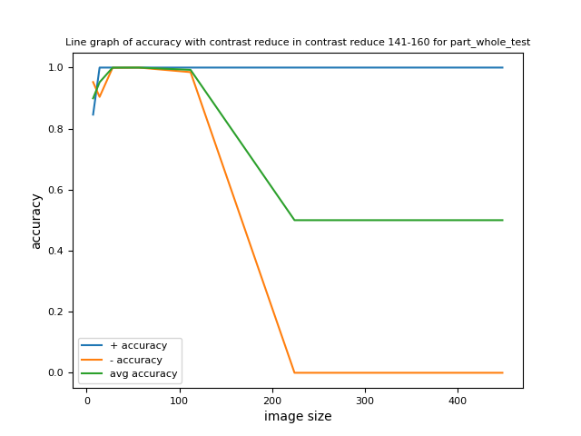
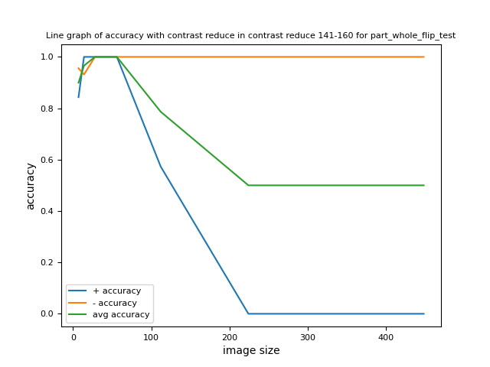
Compare with different image sizes

Slide 11
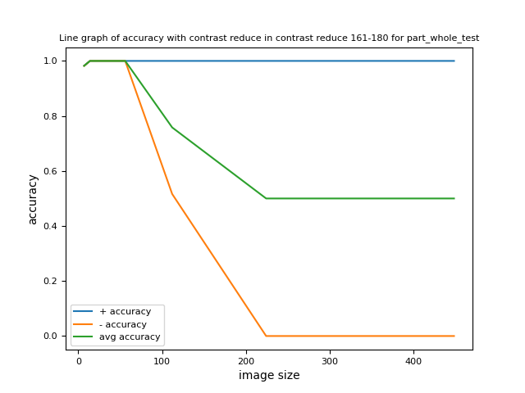
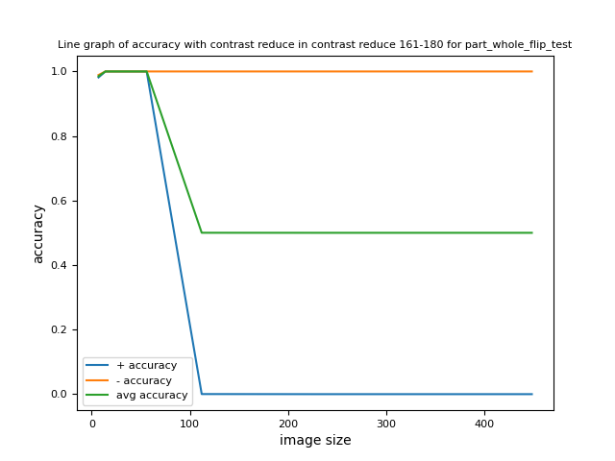
Compare with different image sizes

Slide 12
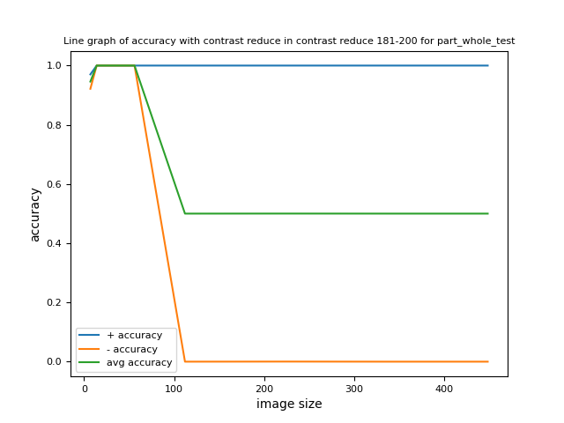
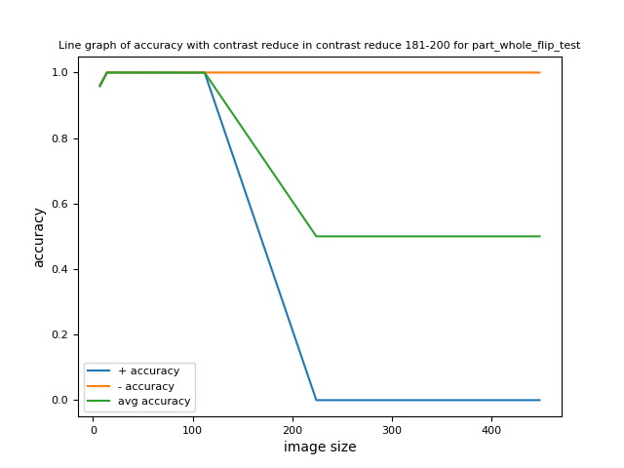
Compare with different image sizes

Slide 13
Compare between part whole test and part whole flip test
Trend with different contrast reduce

Slide 14
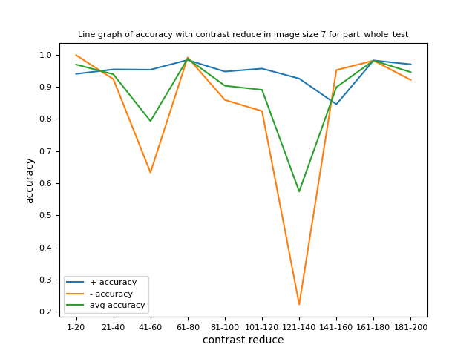
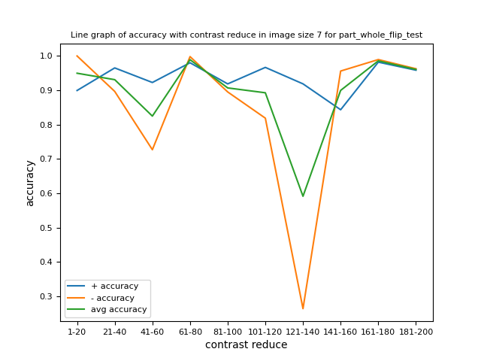
Compare with different contrast reduce
Contrast reduce 121-140 has the lowest contrast

Slide 15
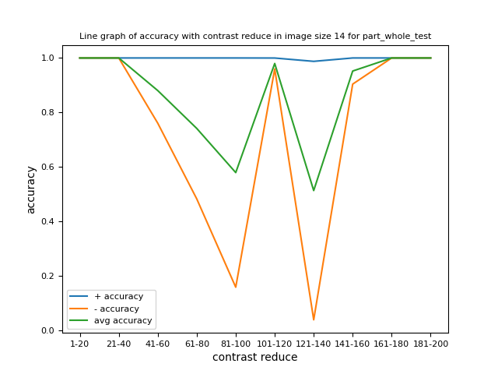
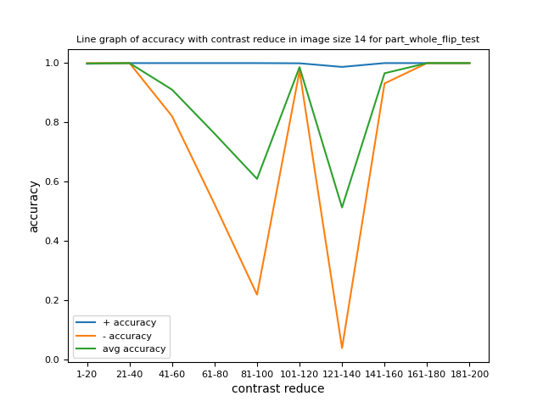
Compare with different contrast reduce

Slide 16
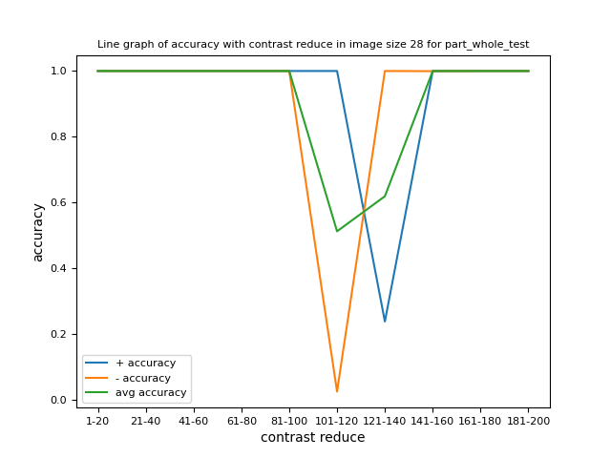

Compare with different contrast reduce

Slide 17
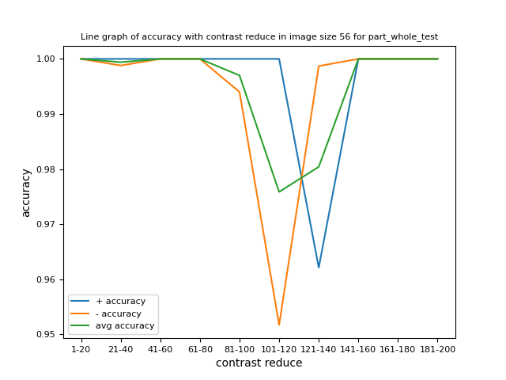
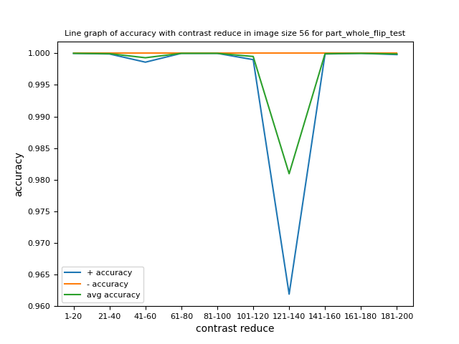
Compare with different contrast reduce

Slide 18
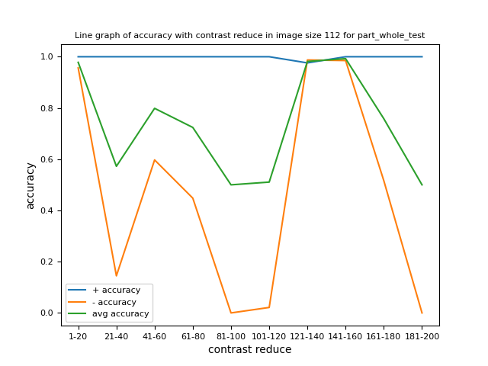
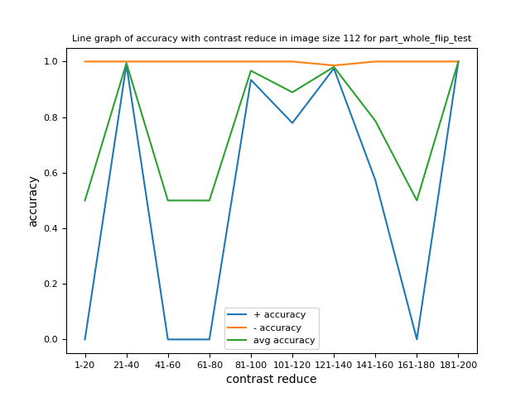
Compare with different contrast reduce
The model tends to classify the image according to the local feature when image size is higher than 56*56.
In part whole test, the model tends to classify all images as plus when image size is higher than 56*56.
In part whole flip test, the model tends to classify all images as minus when image size is higher than 112*112

Slide 19
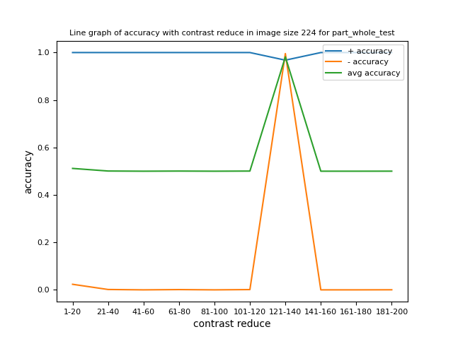
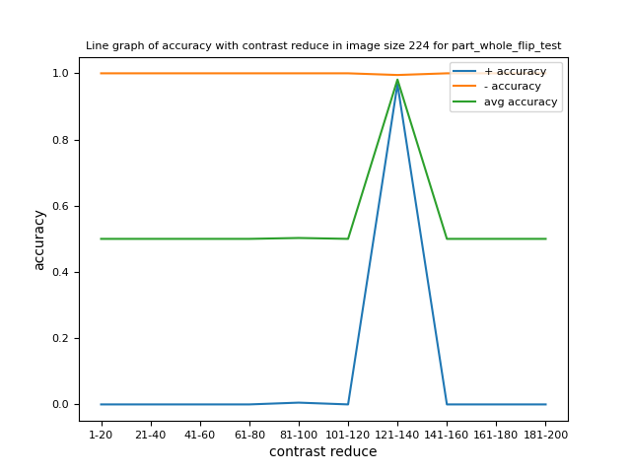
Compare with different contrast reduce
When image contrast is very low (contrast reduce 121-140), the model tends to have high accuracy when image size is larger than 56*56.
Images with contrast reduce 121-140 have the lowest contrast.
When image size is larger than 56*56, low contrast tends to have high accuracy. While when image size is lower than 56*56, high contrast tends to have high accuracy.

Slide 20

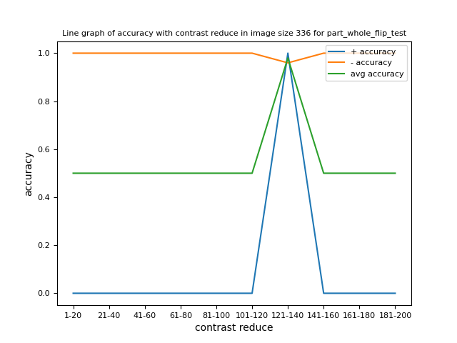
Compare with different contrast reduce

Slide 21


Compare with different contrast reduce

Slide 22
Compare between different image sizes
Trend with different contrast reduce

Slide 23
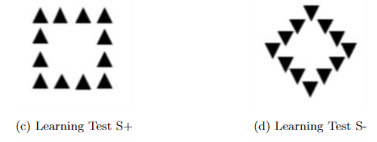

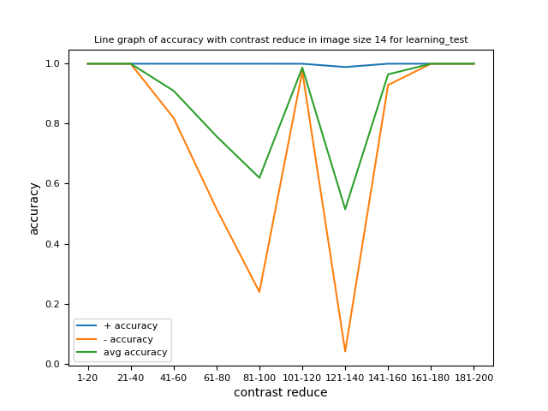

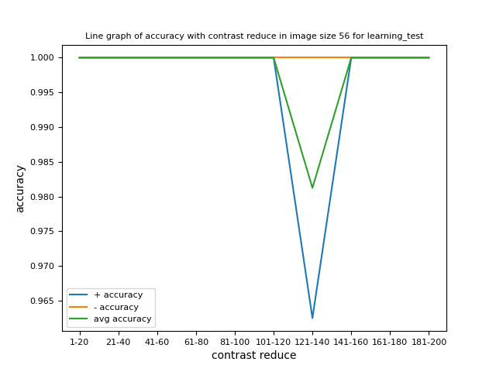
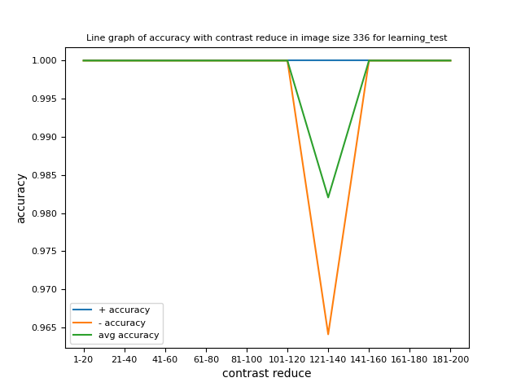

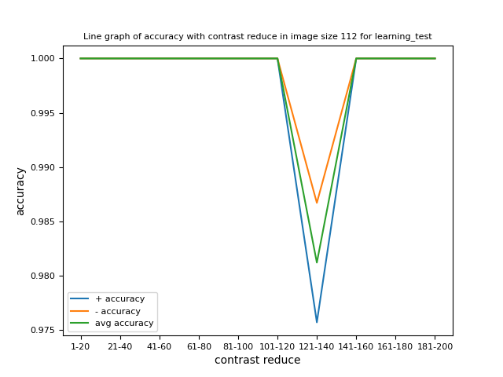
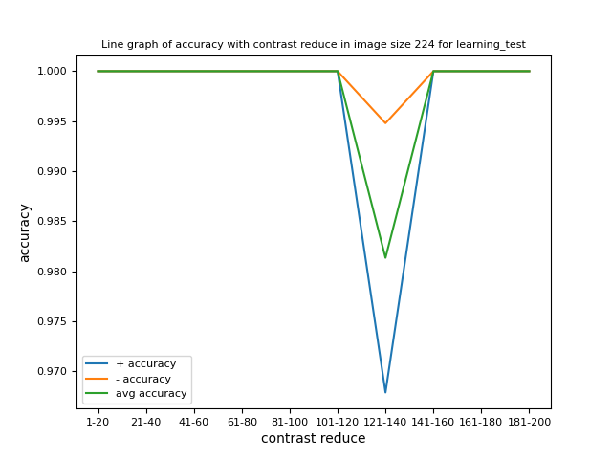
Learning test trend with different contrast reduce for different image sizes
Learning test is with the same pattern as the training dataset.
When image size is less than 28*28 (included), in low contrast (contrast reduce 121-140), it cannot classify the learning test.

Slide 24
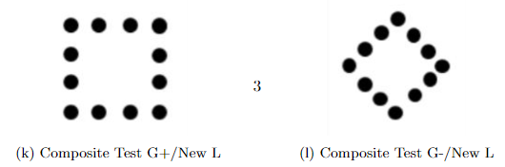
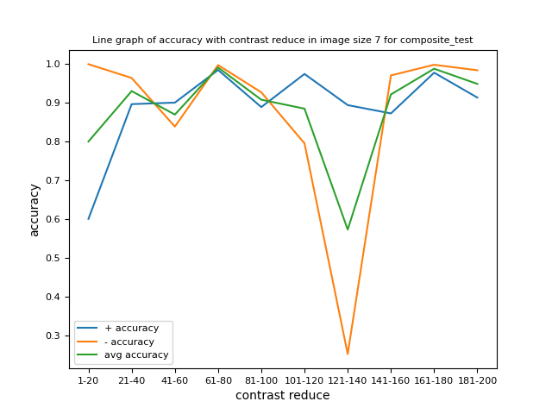
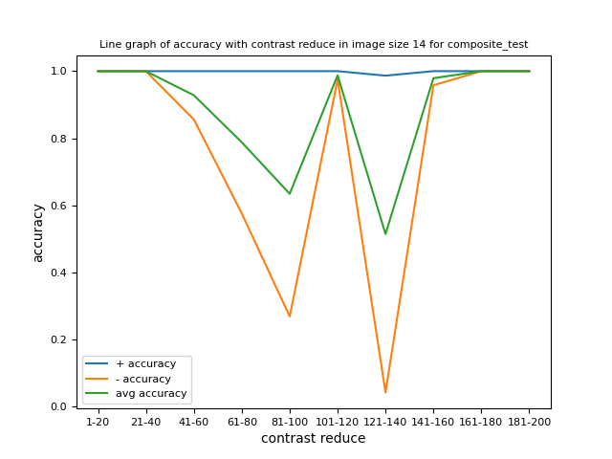
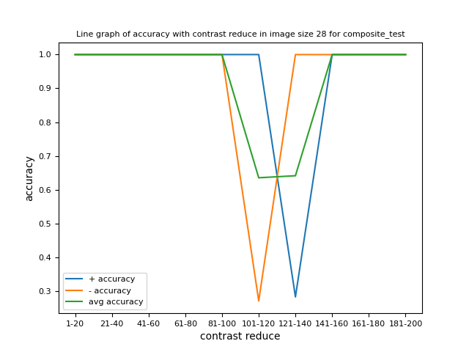

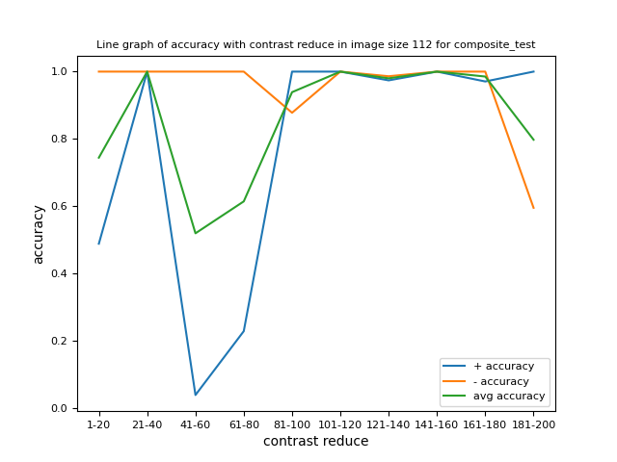
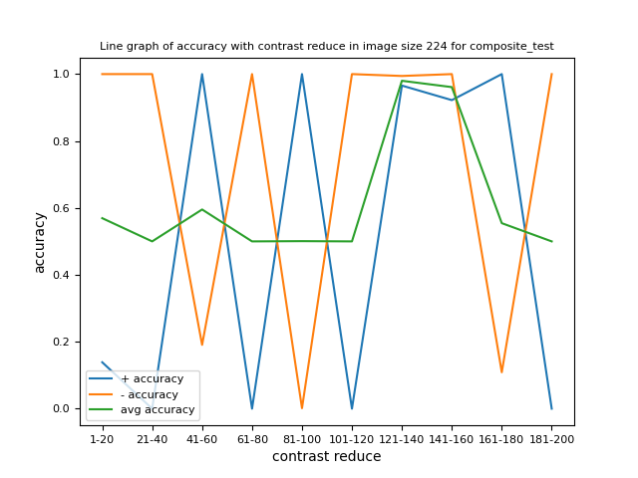
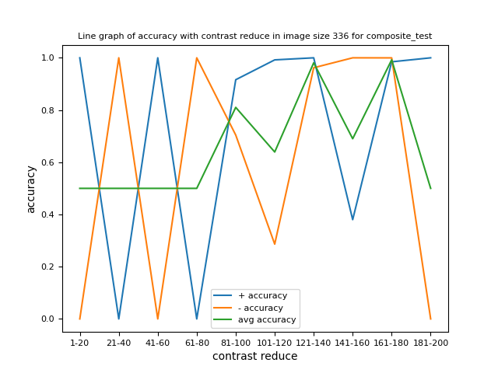
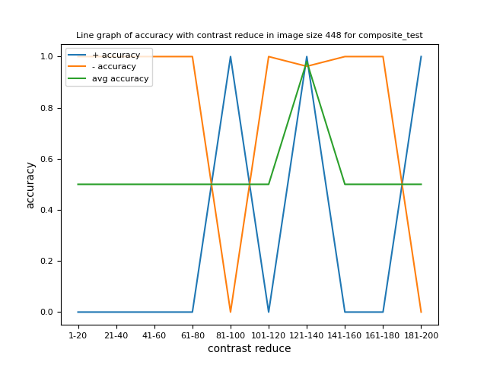
Composite test trend with different contrast reduce for different image sizes
It tends to have high accuracy for all contrast when image size is 56*56 for composite test. (The highlighted graph)
When image size increases, lower contract (closer to 121-140) tends to have higher accuracy.
When image size decrease, higher contract tends to have lower accuracy.

Slide 25
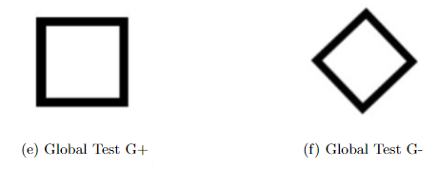








Global test trend with different contrast reduce for different image sizes
It tends to have high accuracy for all contrast when image size is 56*56 or 112*112 for global test. (The highlighted graphs)
When image size increases, lower contract (closer to 121-140) tends to have higher accuracy.
When image size decrease, higher contract tends to have lower accuracy.

Slide 26
Trend with different image sizes
Compare between different contrast reduce

Slide 27










Learning test trend with different image sizes for different contrast reduce

Slide 28










Composite test trend with different image sizes for different contrast reduce

Slide 29










Global test trend with different image sizes for different contrast reduce

Slide 30
Training Data Sample for Different Contrast

Slide 31






Contrast reduce 1-20

Slide 32






Contrast reduce 21-40

Slide 33






Contrast reduce 41-60

Slide 34






Contrast reduce 61-80

Slide 35






Contrast reduce 81-100

Slide 36






Contrast reduce 101-120

Slide 37






Contrast reduce 121-140
Contrast reduce 121-140 has the lowest contract.

Slide 38






Contrast reduce 141-160

Slide 39






Contrast reduce 161-180

Slide 40






Contrast reduce 181-200

